Slide 1

DATA 607 - Project 3
Data Science Skills
Noori Selina, Haig Bedros, Gavriel Steinmetz-Silber, Zainab Oketokoun
Notes:
Selina

Slide 2

Introduction
Project Overview: Our project aims to utilize data to answer the question, "Which are the most valued data science skills?"
We will analyze Data Science job postings to determine which of the qualifications are common amongst the job postings.
Objectives:
Identify the most frequently mentioned skills in Data Science job postings.
Utilize data to determine the most valued data science skills based on their frequency.
Notes:
Selina

Slide 3

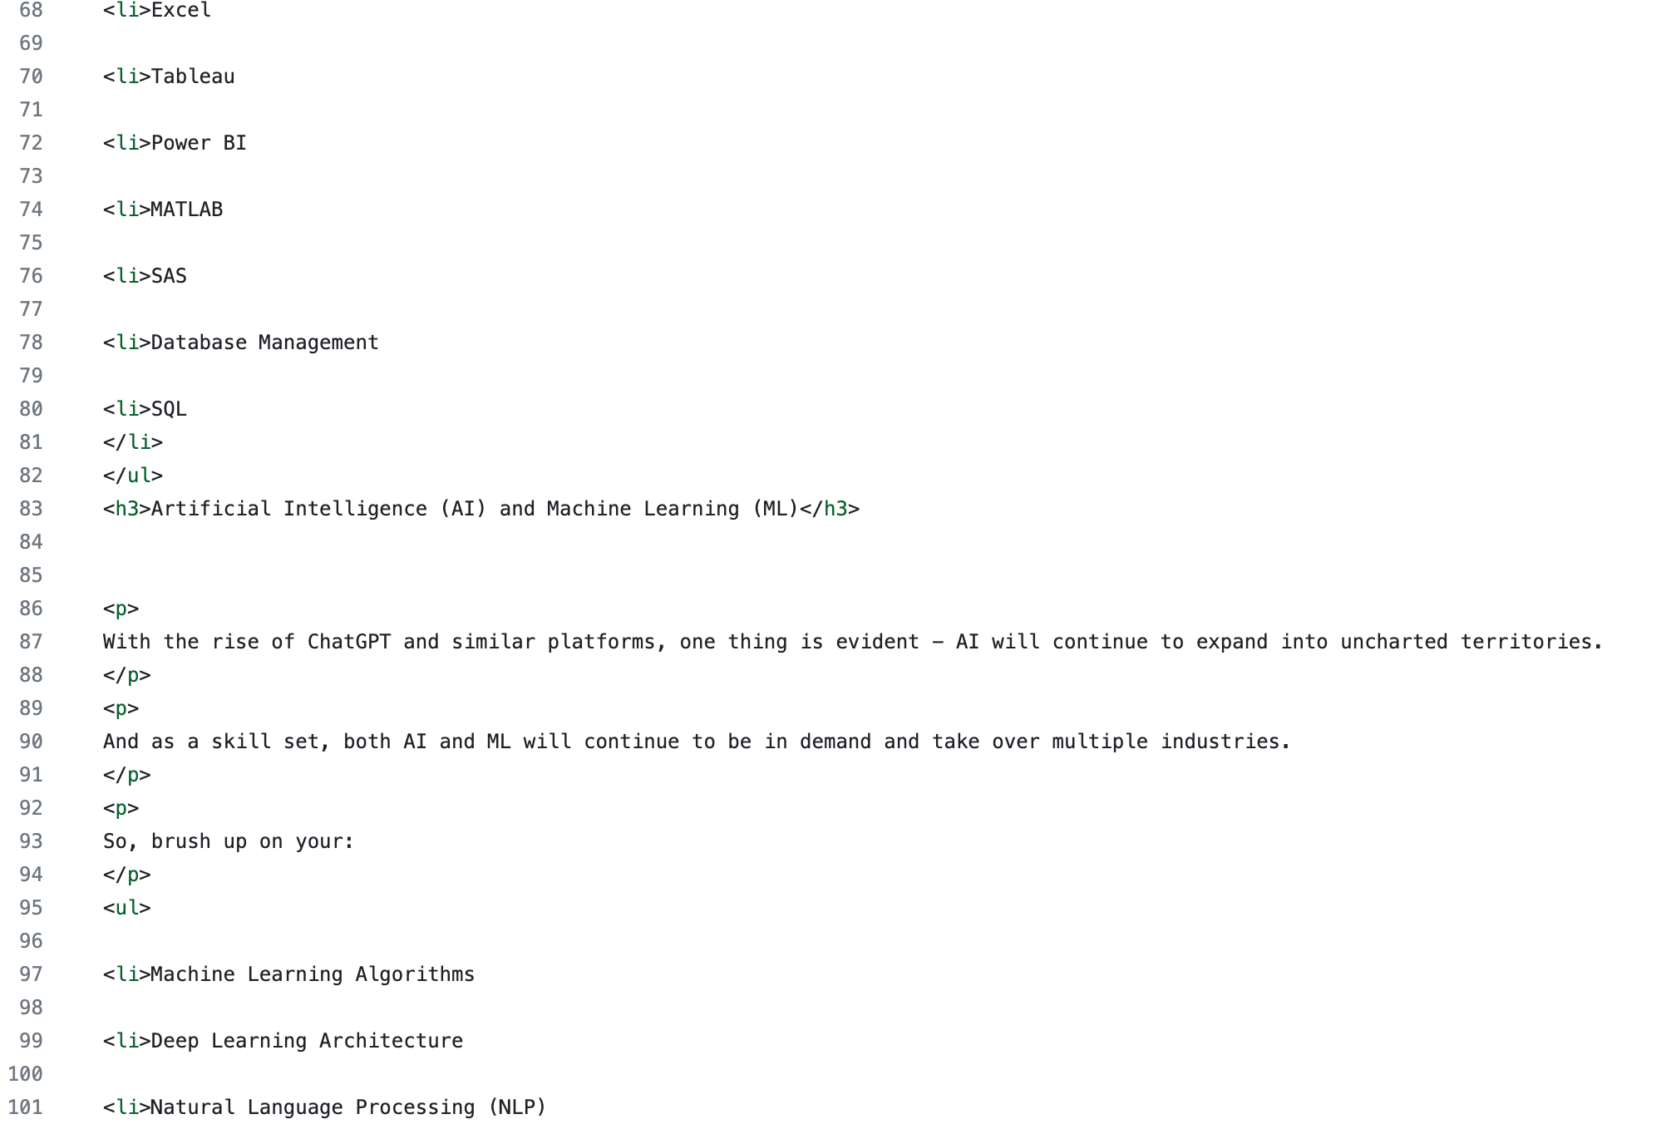
Data Gathering and Source
Primary Data Source: "LinkedIn Job Postings - 2023" dataset
Consists of 15,000 job postings listed on LinkedIn over a two-day period and
job title
job description
salary details
Location
work types.
[LinkedIn Job Postings - 2023 on Kaggle] (https://www.kaggle.com/datasets/arshkon/linkedin-job-postings)
Secondary Data Source: The secondary data source involves gathering a list of common skills from https://enhancv.com/resume-skills
The skills were all HTML list items
We wrote a function to create a skills column with matching terms
Notes:
Selina

Slide 4

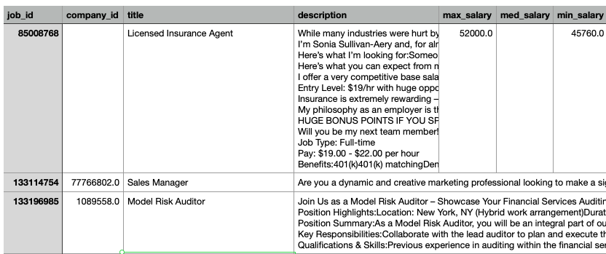

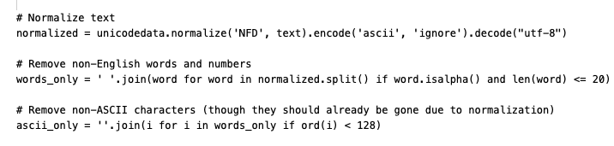
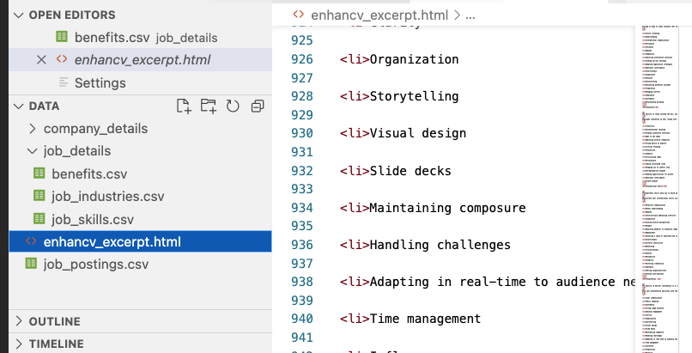
Data Clean Up
CSV Cleanup:
Addressed dataset integrity issues.
Utilized Python's pandas and Unicode for data conversion.
Normalized data to reduce inconsistencies.
Established primary and foreign keys for relational integrity.
HTML Processing:
Used grep() to specifically extract data science roles.
Optimized the dataset by removing unnecessary columns.
Used rvest and created a function to create a skills column

Slide 5



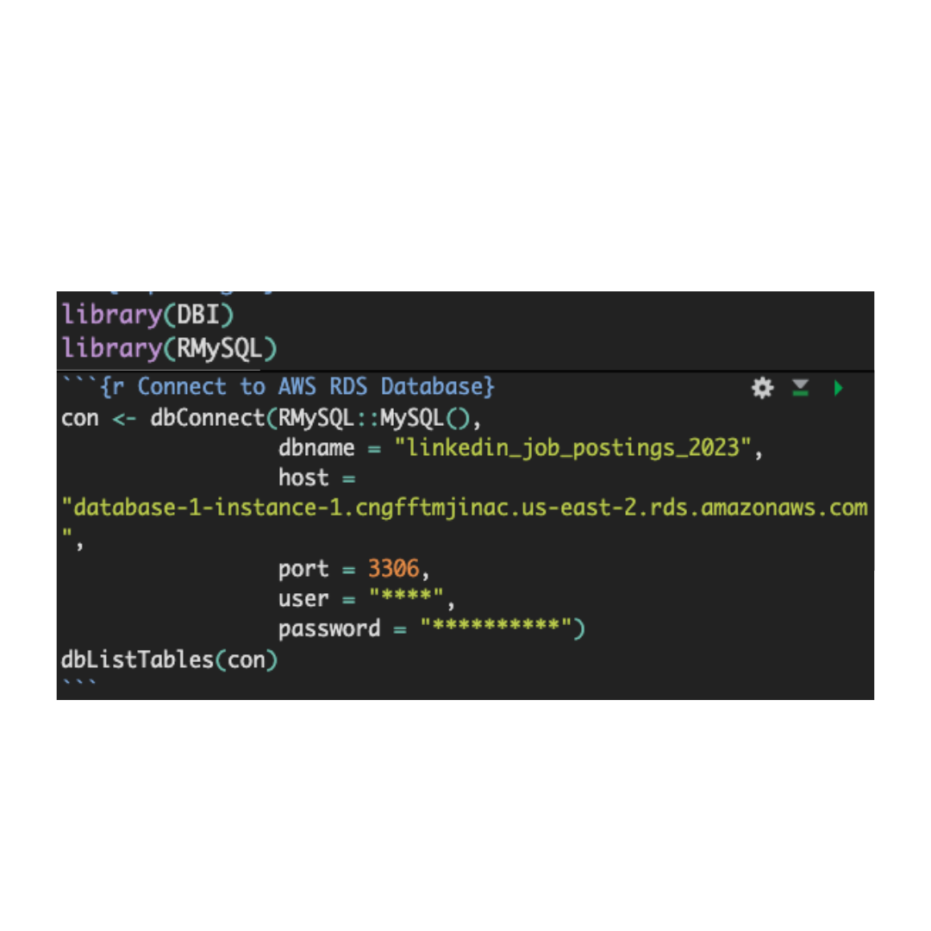
Database Setup and Data Migration
Amazon RDS Database Setup:
Centralized database for project members.
Details: Endpoint in us-east-2, Port 3306, Publicly Accessible.
MySQL Data Migration:
Transferred cleaned dataset to RDS.
Steps: Convert CSV to SQL, established keys, imported data, and validated post-migration integrity.
R Connection:
Notes:
Haig

Slide 6
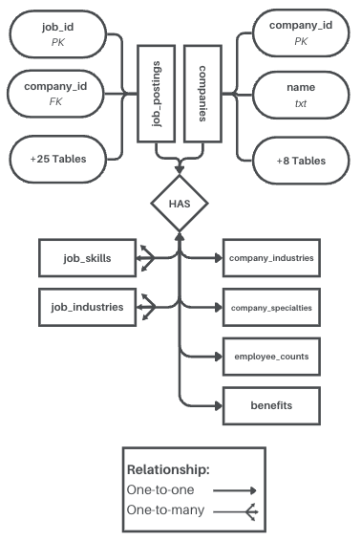
Data Normalization & Relational Model
Goal: Streamline dataset for efficient analysis and reduce redundancy.
Techniques: Used Amazon RDS with MySQL, refined data structure with primary and foreign keys.
Achievements: Improved data consistency and query efficiency.
Model: Established key relationships (e.g., job_postings to companies) adhering to Third Normal Form (3NF).
Notes:
Haig

Slide 7
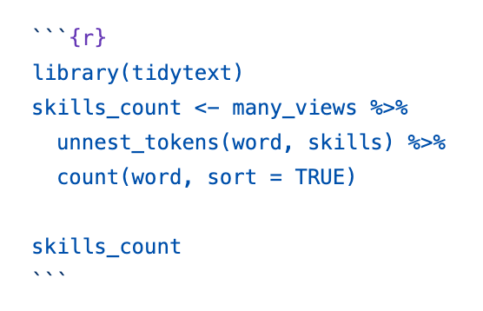
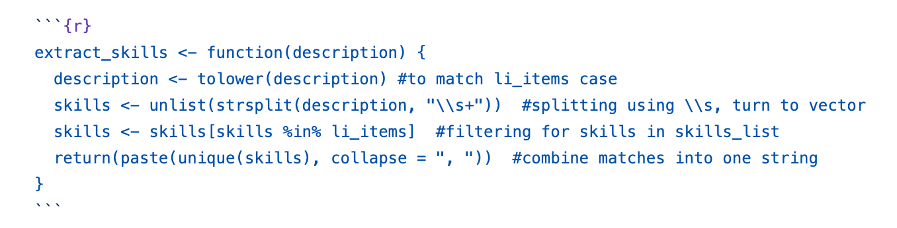
Data Analysis - Part I
Data Filtering: The primary dataset was filtered to include only data science-related roles.
Skills Extraction: Skills mentioned in job descriptions were extracted to compile a list of relevant qualifications.
Focus on Top Job Listings: The analysis concentrated on the most-viewed job listings by calculating the 75th percentile of views.
Skills Ranking Table: A table was created to rank the skills based on their frequency within these highly viewed job listings, providing insights into the most valued qualifications.

Slide 8
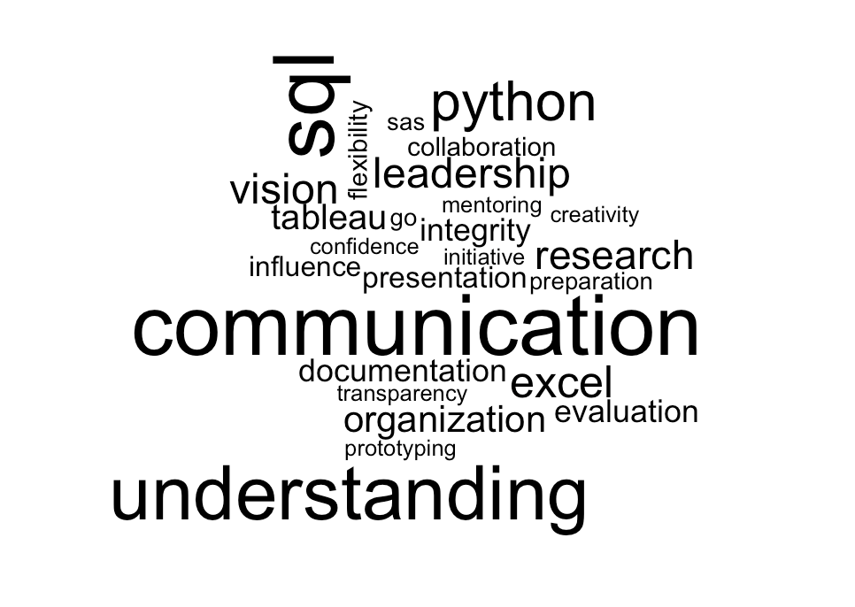
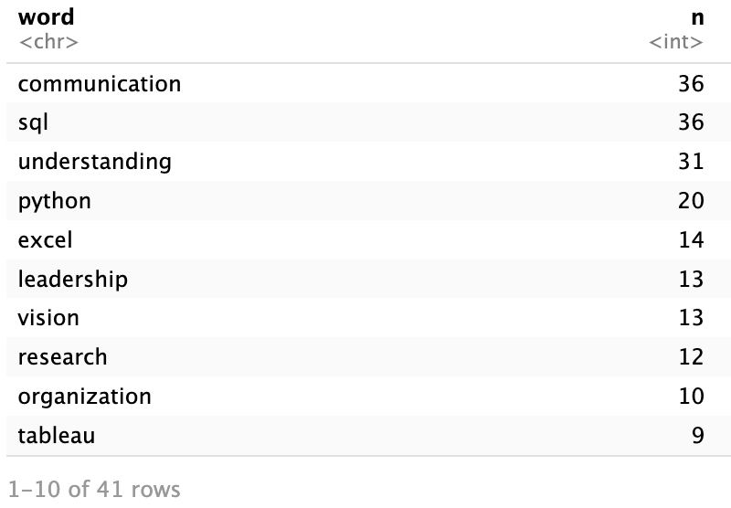
Analysis Part I Results
In the most viewed (and plausibly most desirable) data science-related postings, many of the skills are not technical at all! In fact, of the top 3 skills, 2 are "communication" and "understanding."
Notes:
Part 1 Gav

Slide 9
Data Analysis - Part II
Next, all data science job postings were considered to assess skills across the entire spectrum.
Data Science Skills Overview: The dataset was analyzed to identify the most frequently occurring skills for data science job postings.
Counting Skills: The skills extracted from all job descriptions were tokenized, counted, and ranked in descending order.
Notes:
Part 2 Selina

Slide 10
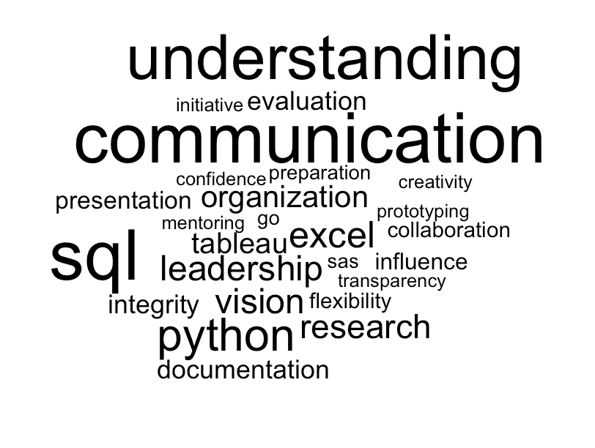
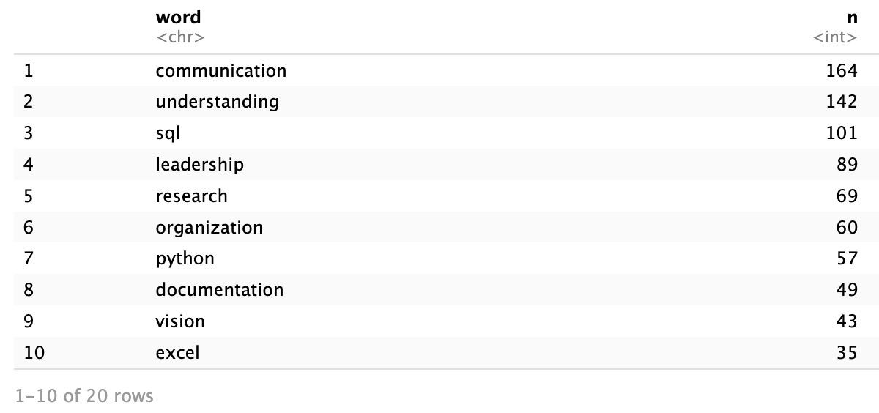
Analysis Part II Results
The Part I results were not an anomaly
This time, the top two skills were non-technical.
Notes:
Selina talks about Visualization

Slide 11
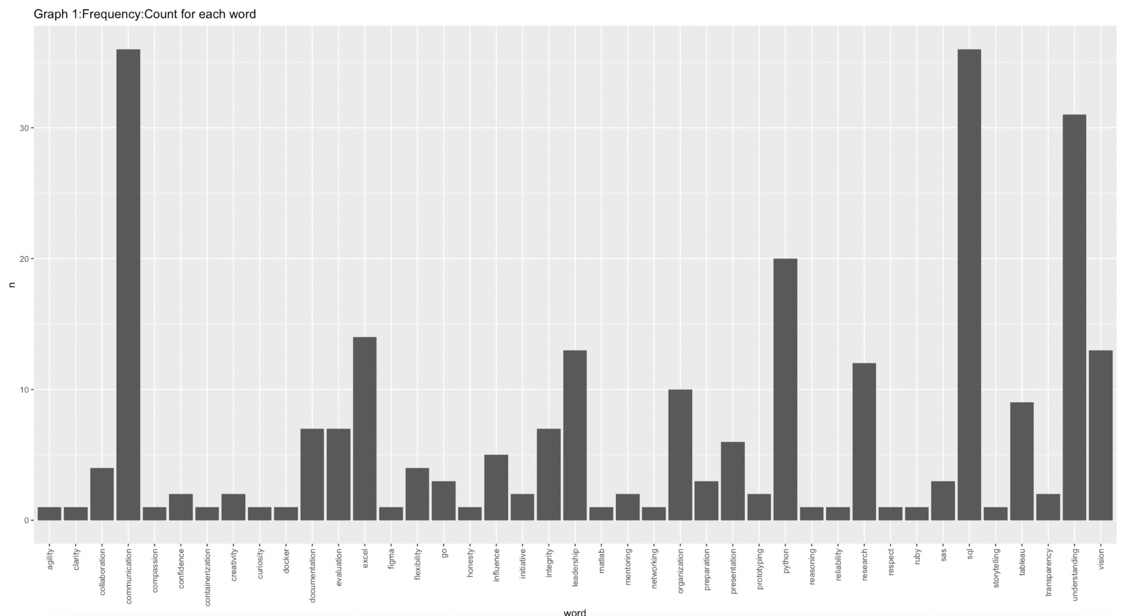
Analysis Visual

Slide 12
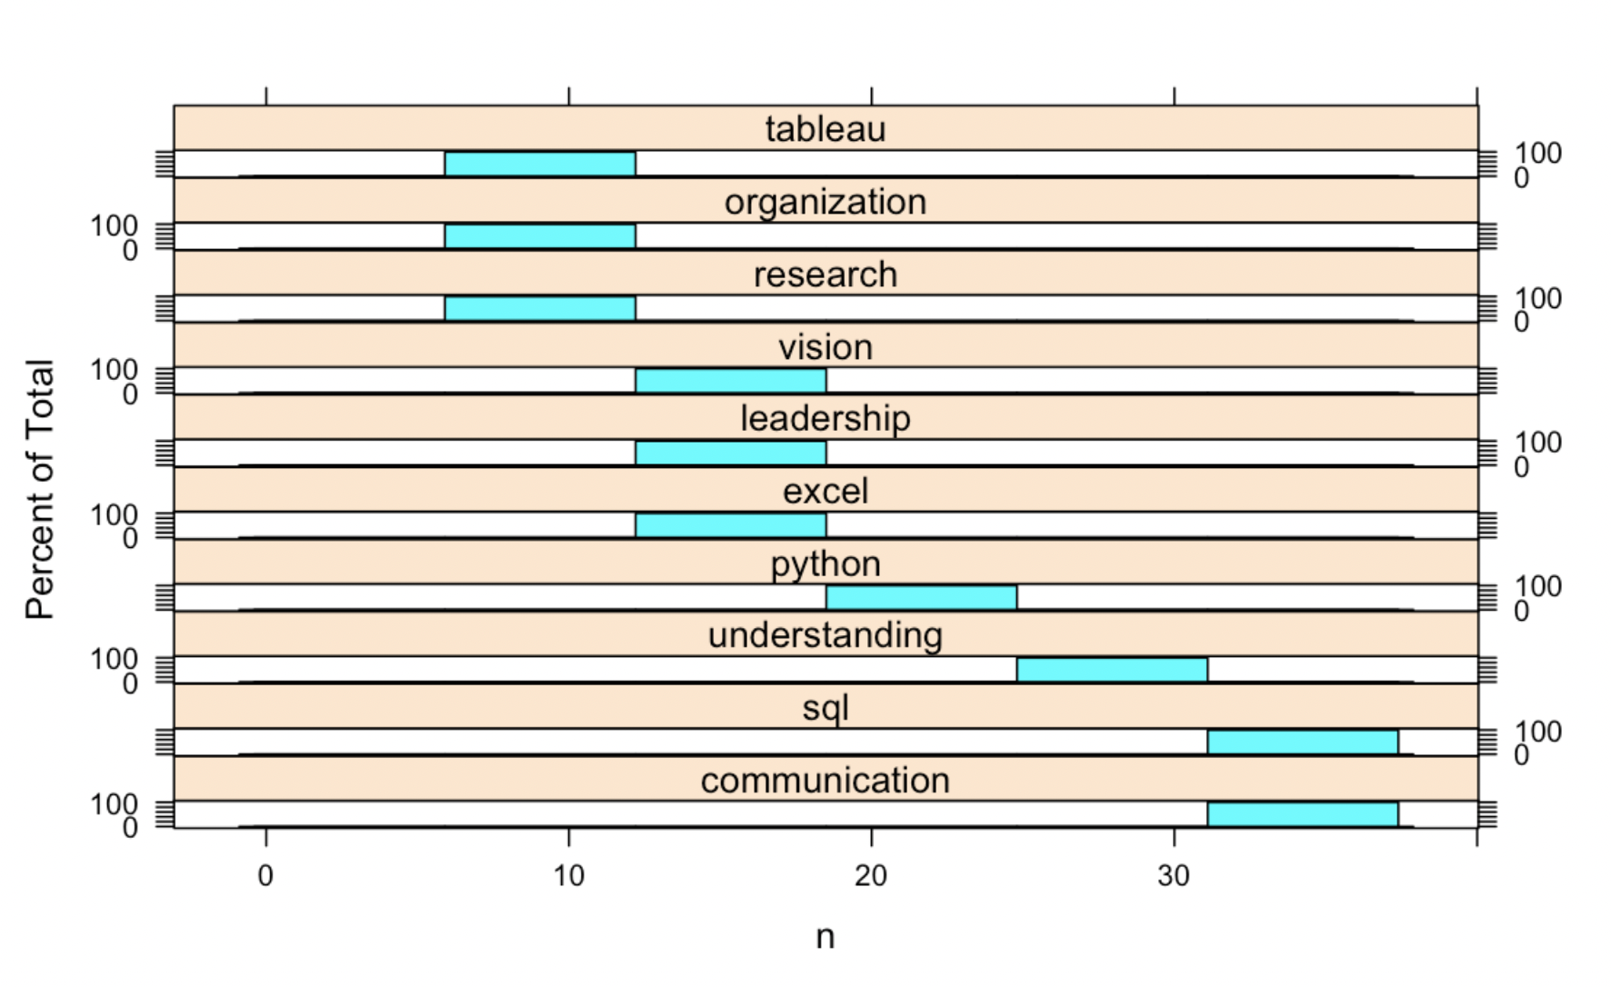
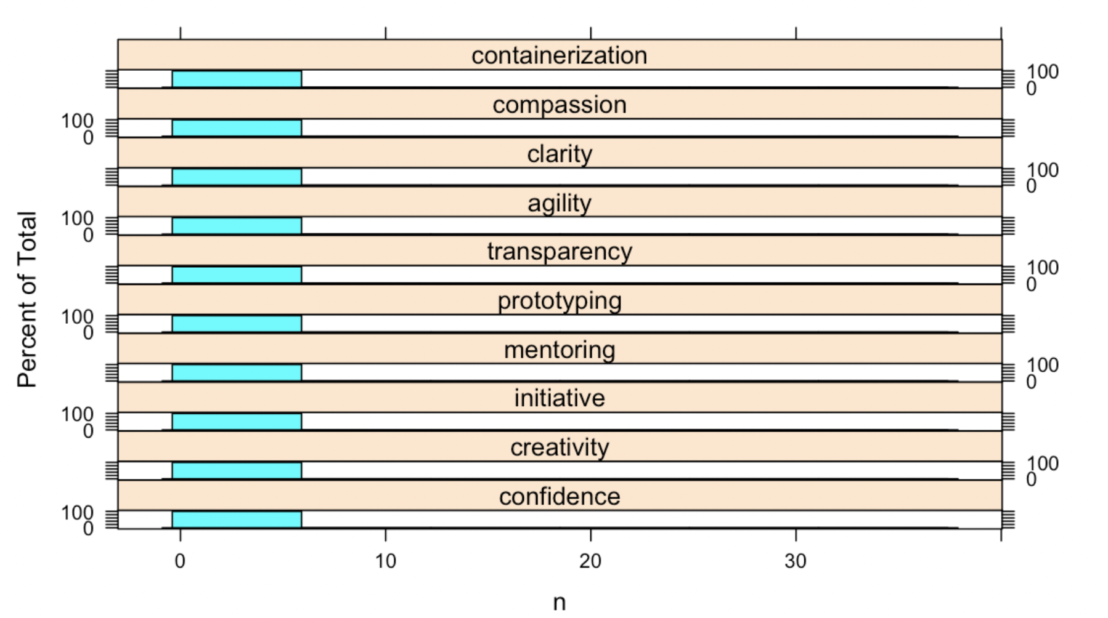
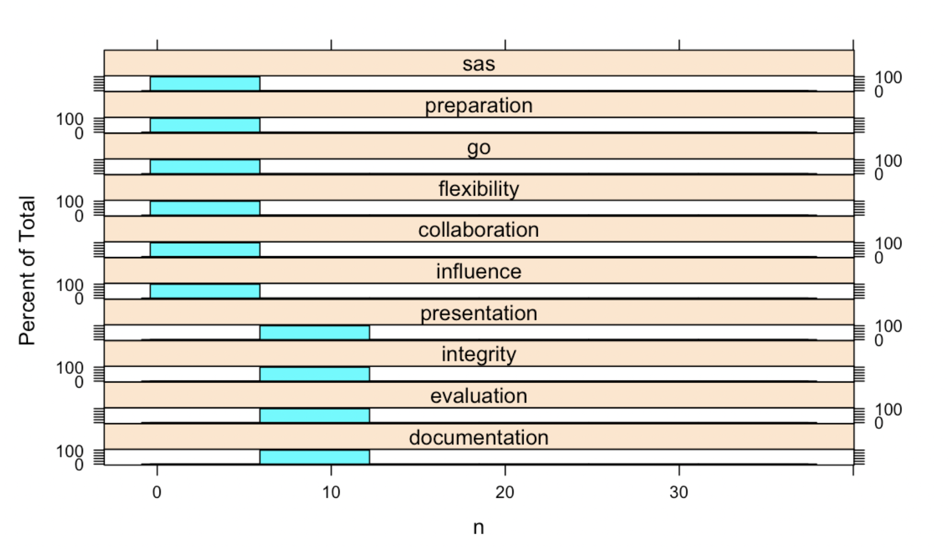
What are
the Soft skills
Understanding | the 'awareness of the connection between the individual pieces of this information'
Communication | listening, respect, Empathy feedback
Leadership | Conflict management, agility, adaptability, positivity, time management
Vision/Visionary | Innovation, communication
Presentation | Body language, storytelling, active engagement, delivery

Slide 13

Conclusions & Recommendations
Conclusion:
Top data science roles value soft skills; SQL, Excel, and Python also important.
Over 50% of skills mentioned <20 times.
Recommendations:
Need larger sample for better analysis.
Data science focuses on growth and collaboration.
Social psychology courses beneficial.
Future Works:
Examine skills by position level.

